Slide 1

Curriculum Meeting 2026
Welcome to the start of a new academic year at Riverbridge Primary School.

Slide 2
Welcome to Year 6
Year Group Leader: Mrs Woodhart
Class teachers: Mrs King and Mrs Bond
Year 6 team: Mr Glynn, Mrs Enderby, Mrs Aldred, Mrs Jimenez, Mrs Howell and Mrs Jones
Headteacher: Mr Grimwood
Deputy Headteacher: Mrs Price
Phase Leader: Miss Heffernan
Inclusion Leader: Miss Code
Pastoral Team: Mrs Wallace, Mrs Hughes, Mrs Lenton-Clark

Slide 3
If you have a concern
Please follow the order below:
Class Teacher
Year Leader
Phase Leader
Further Senior Leadership Members: Mrs Price, Mr Grimwood
Pastoral Team

Slide 4
The School Day
The gate and classroom doors open at 8:35am – 8:50 am.
Parents will continue to drop off at the gates, although any messages can be passed through the school office.
Children are collected from the classroom door at 15.20 the end of the day.
Gates will close at 15.30

Slide 5
Breaktimes
Morning break times will be from 10.40-10.55.
At PAB, the children will share the playground space but also have access to the large field area depending on the weather.
Children can play football on Wednesday. Please keep an eye on the newsletter as children will be asked to bring a change of shoes as the weather changes.
Children can bring a healthy snack from home.
Lunchtime will be from 12:00 – 12:55pm.
The children will be able to play on the trim trail and with a range of Play Pod resources.

Slide 6
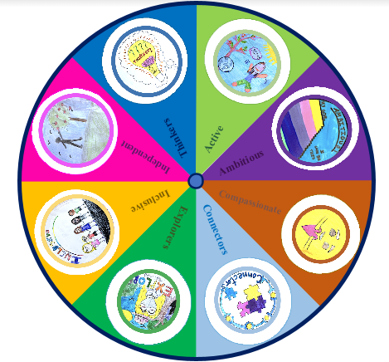
Behaviour
Stay on Green
Green tokens and green time
Gold leaves
Reflection time
Motto: ‘Being our Best.’
8 Great Values

Slide 7
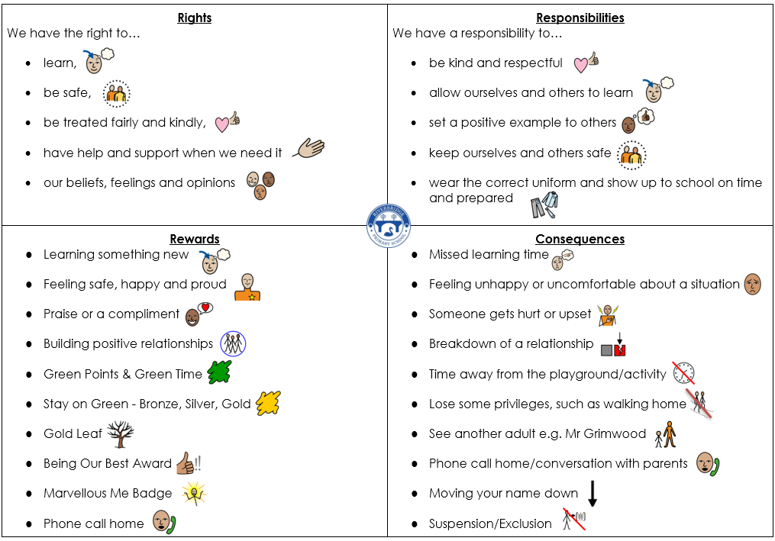
Behaviour

Slide 8
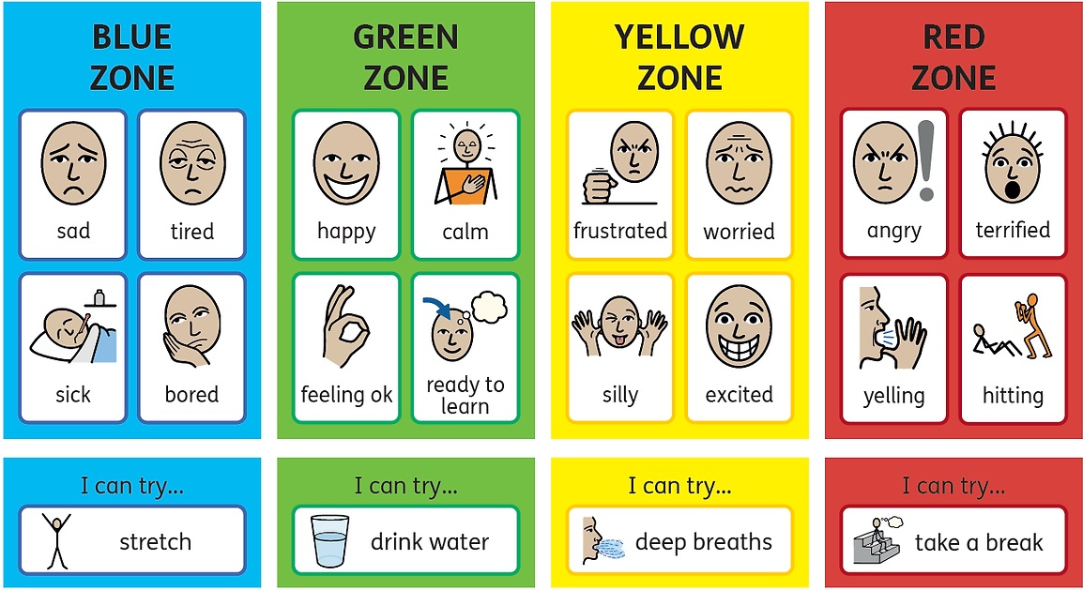
Wellbeing – Zones of Regulation

Slide 9
Our Curriculum:
Autumn 1 | Autumn 2 | Spring 1 | Spring 2 | Summer 1 | Summer 2
World War One, Two and Windrush | World War One, Two and Windrush | World Knowledge and Times zones | The History of Staines | Mountains and Volcanoes | Maya
Every half term you will be able to find the curriculum map on Google Classroom.

Slide 10

PE in Year 6
PE will be taught on Wednesday.
Children must remove their earrings before taking part in PE.
Children should wear their PE kits into school.
Topics include:
Handball, Basketball, Netball, Tennis, Dance, Gymnastics, Badminton, Rounders, Athletics

Slide 11
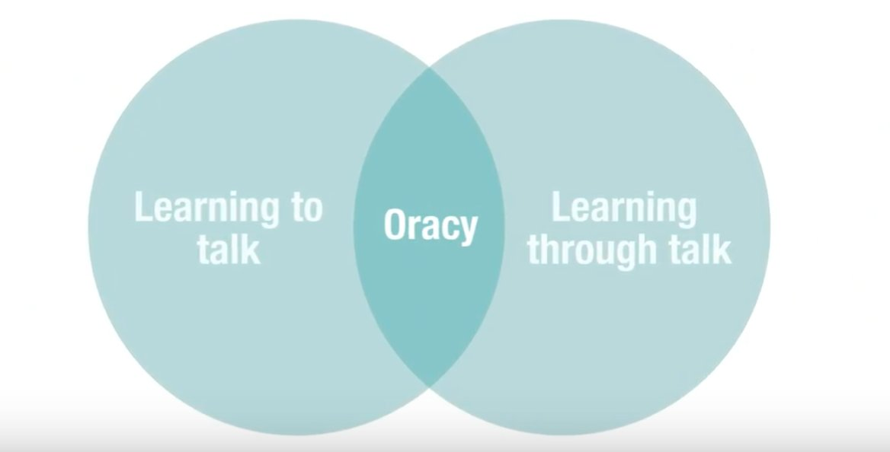
Oracy
Still a priority for Riverbridge this year
In the classroom context, oracy is both learning to and through talk. It is through talk that students have the opportunity to develop and share their understanding, through interactions with both teachers and peers. However, to do this effectively, students must also be taught to talk effectively, ensuring they have the necessary skills and understanding to engage in talk for learning.

Slide 12
End of Key Stage Assessments
May 2027 (Monday 10th May – Thursday 13th May 2027)
English:
Grammar (1 paper)
Spelling (1 paper)
Reading comprehension (1 paper)
Writing - Moderated teacher assessment
Maths:
Arithmetic (1 paper)
Reasoning (2 papers)
More information at the Assessment Information Evening in the Spring term.
Science:
Moderated teacher assessment

Slide 13
Assessment in Year 6
The curriculum aims for pupils to ‘meet’ year group expectations.
Working towards
Working within
Exceeding
Your child’s progress will be shared at parents’ meetings and in an annual report.

Slide 14
Home Learning in Year 6
Home learning will be sent out via Google Classroom on a Thursday and be returned on the following Tuesday.
At the beginning of each half term, a Home Learning Review will be set. This includes a wide range of tasks linked to learning from the previous half term. Children are expected to do at least one task each half term.
1 piece of English (CGP Book)
1 piece of Maths (CGP Book)
Reading 3 x a week – please write in and sign Reading Record.

Slide 15

Plans are firmly in place and we are all very much looking forward to our residential.
Further details to follow.
Bowles Year 6
Monday 18th January until Friday 22nd January

Slide 16
Parental Empowerment
At Riverbridge, we want all parents to feel empowered to be a part of school life.
If you wish to discuss anything, please do so via the office or arrange an appointment with the class teacher.
Things your child has done in the school day will also be shared regularly via the Marvellous Me app.
Each half term, you will receive a curriculum map which will outline the coverage of the curriculum which is being taught. These will be added to Google Classroom and the school website.

Slide 17
How to support your child:
Support with any home learning.
Reading at least 3 times per week.
Application of learning in real life context e.g. measure, money, time schedule
Please do not read the class texts at home before we have completed them in class

Slide 18
How to support your child:
Please monitor your child's use of technology including their phones. As a school we do this with all of our technology and will notify you of any issues that are flagged.
Phones will be locked away during the day at school to ensure they are safe. It is your child’s responsibility to collect their phone at the end of the school day, and use it responsibly on their way home.
If your child has any issues with E-safety, please let the office know via email if it likely cause issues within school. This means that we as a school can act accordingly e.g. Teaching a reminder lesson on rights and responsibilities when using technology.

Slide 19
Preparation for Secondary School:
Independence
Responsibility
Confidence
Open Evenings
Deadline for secondary application is 31st October Check your emails as you have been sent a leaflet with more information.

Slide 20
Thank you for listening and we are looking forward to working with you and your children this year!

